Slide 1



WAY TO ENTERPRISE
GIT/GITHUB FUNDAMENTALS
Get started with Git / GitHub

Slide 2

AGENDA
1
Git / GitHub Overview
2
Git Repository - Recording Changes
3
Basic Git Commands
4
Working with GitHub

Slide 3

GIT / GITHUB OVERVIEW

Slide 4

What is Git?
Git is a Distributed Version Control System (DVCS) designed to manage software development projects.
It tracks changes to a codebase over time, allowing developers to collaborate with others, work on multiple branches of code, and roll back to previous versions of the code as needed.
Distributed Version Control System (DVCS)

Slide 5



What is GitHub?
GitHub is a web-based platform that helps you host, manage, and collaborate with other developers on remote repositories.
It also provides you many features for project management.
There are other products that provide the same features as GitHub, such as Bitbucket and GitLab.
Notes:
It’s important to note that Git and GitHub are not the same thing. Git is a Version Control System that is installed locally on your computer to help you manage the history of your source code, while GitHub is a web-based hosting service for Git repositories.

Slide 6
GIT REPOSITORY
RECORDING CHANGES

Slide 7
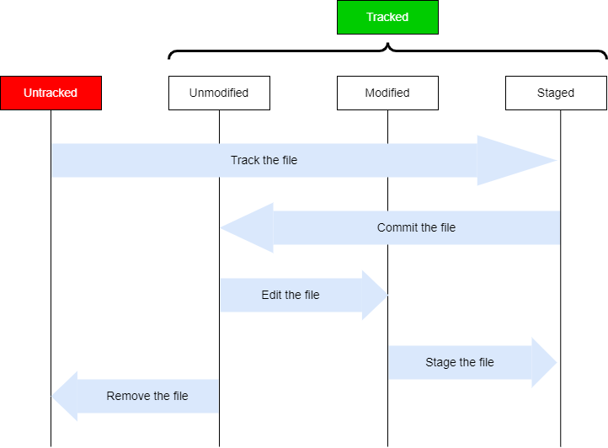
Git Repository - Recording Changes
(Git - Recording Changes to the Repository, 2020)

Slide 8
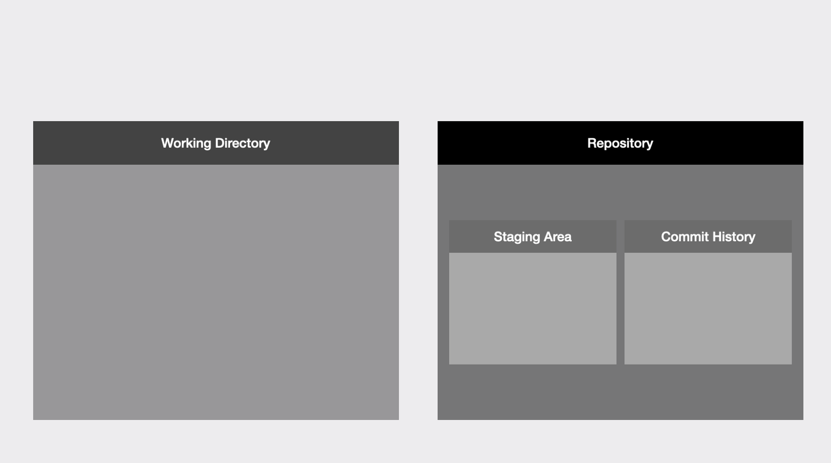
Git Repository - Recording Changes
(Skoulikari, 2021)

Slide 9
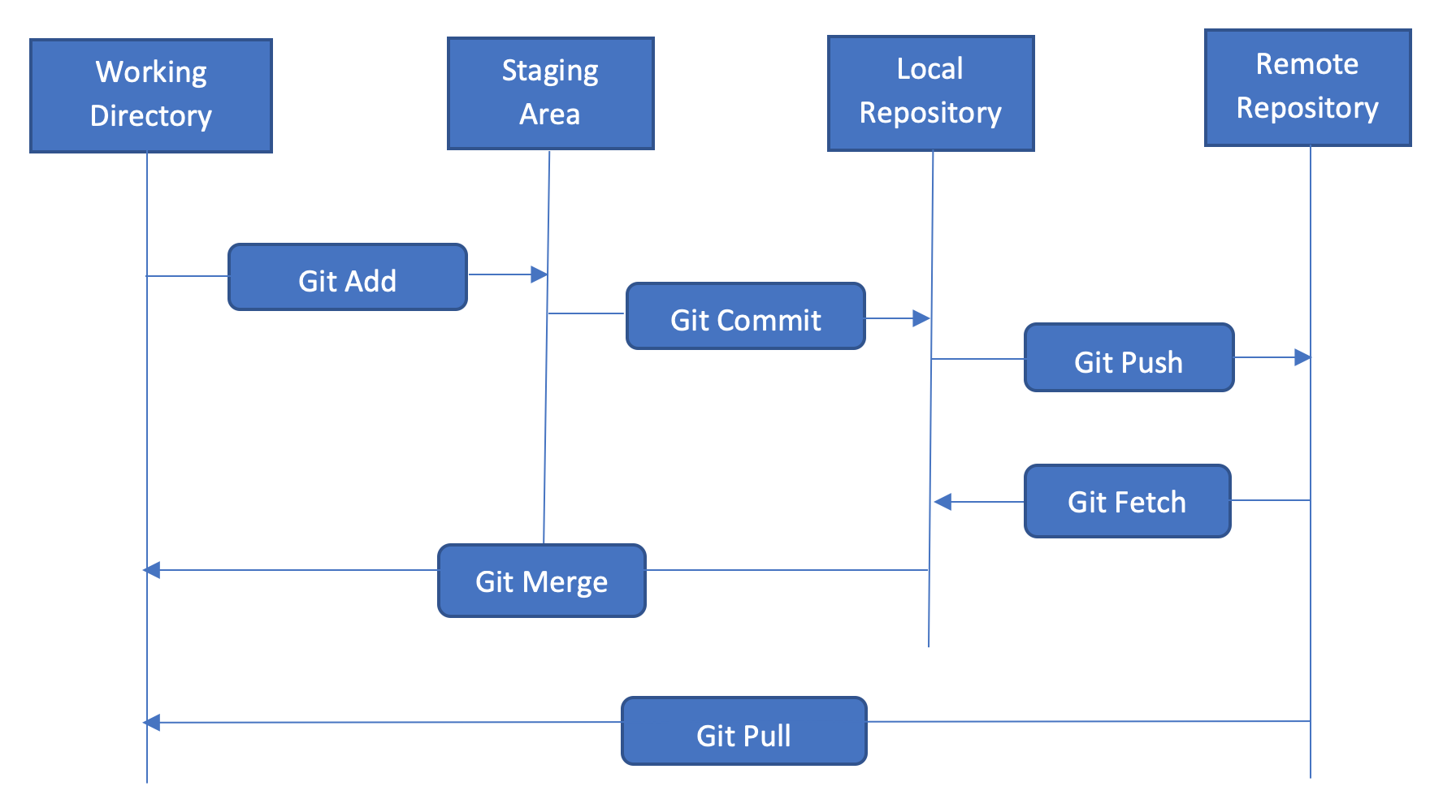
Git Repository - Recording Changes

Slide 10
BASIC GIT COMMANDS

Slide 11
Basic Git Commands
git init
git add
git commit
git branch
git checkout
git log
git merge
git push
git pull

Slide 12
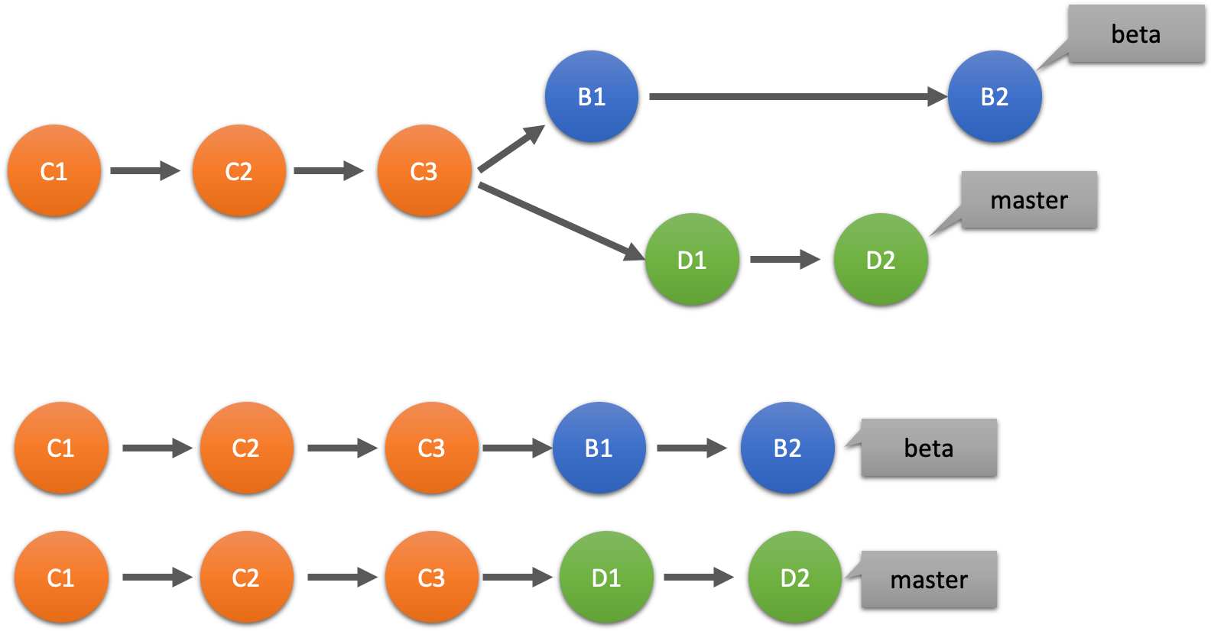
Basic Git Commands

Slide 13
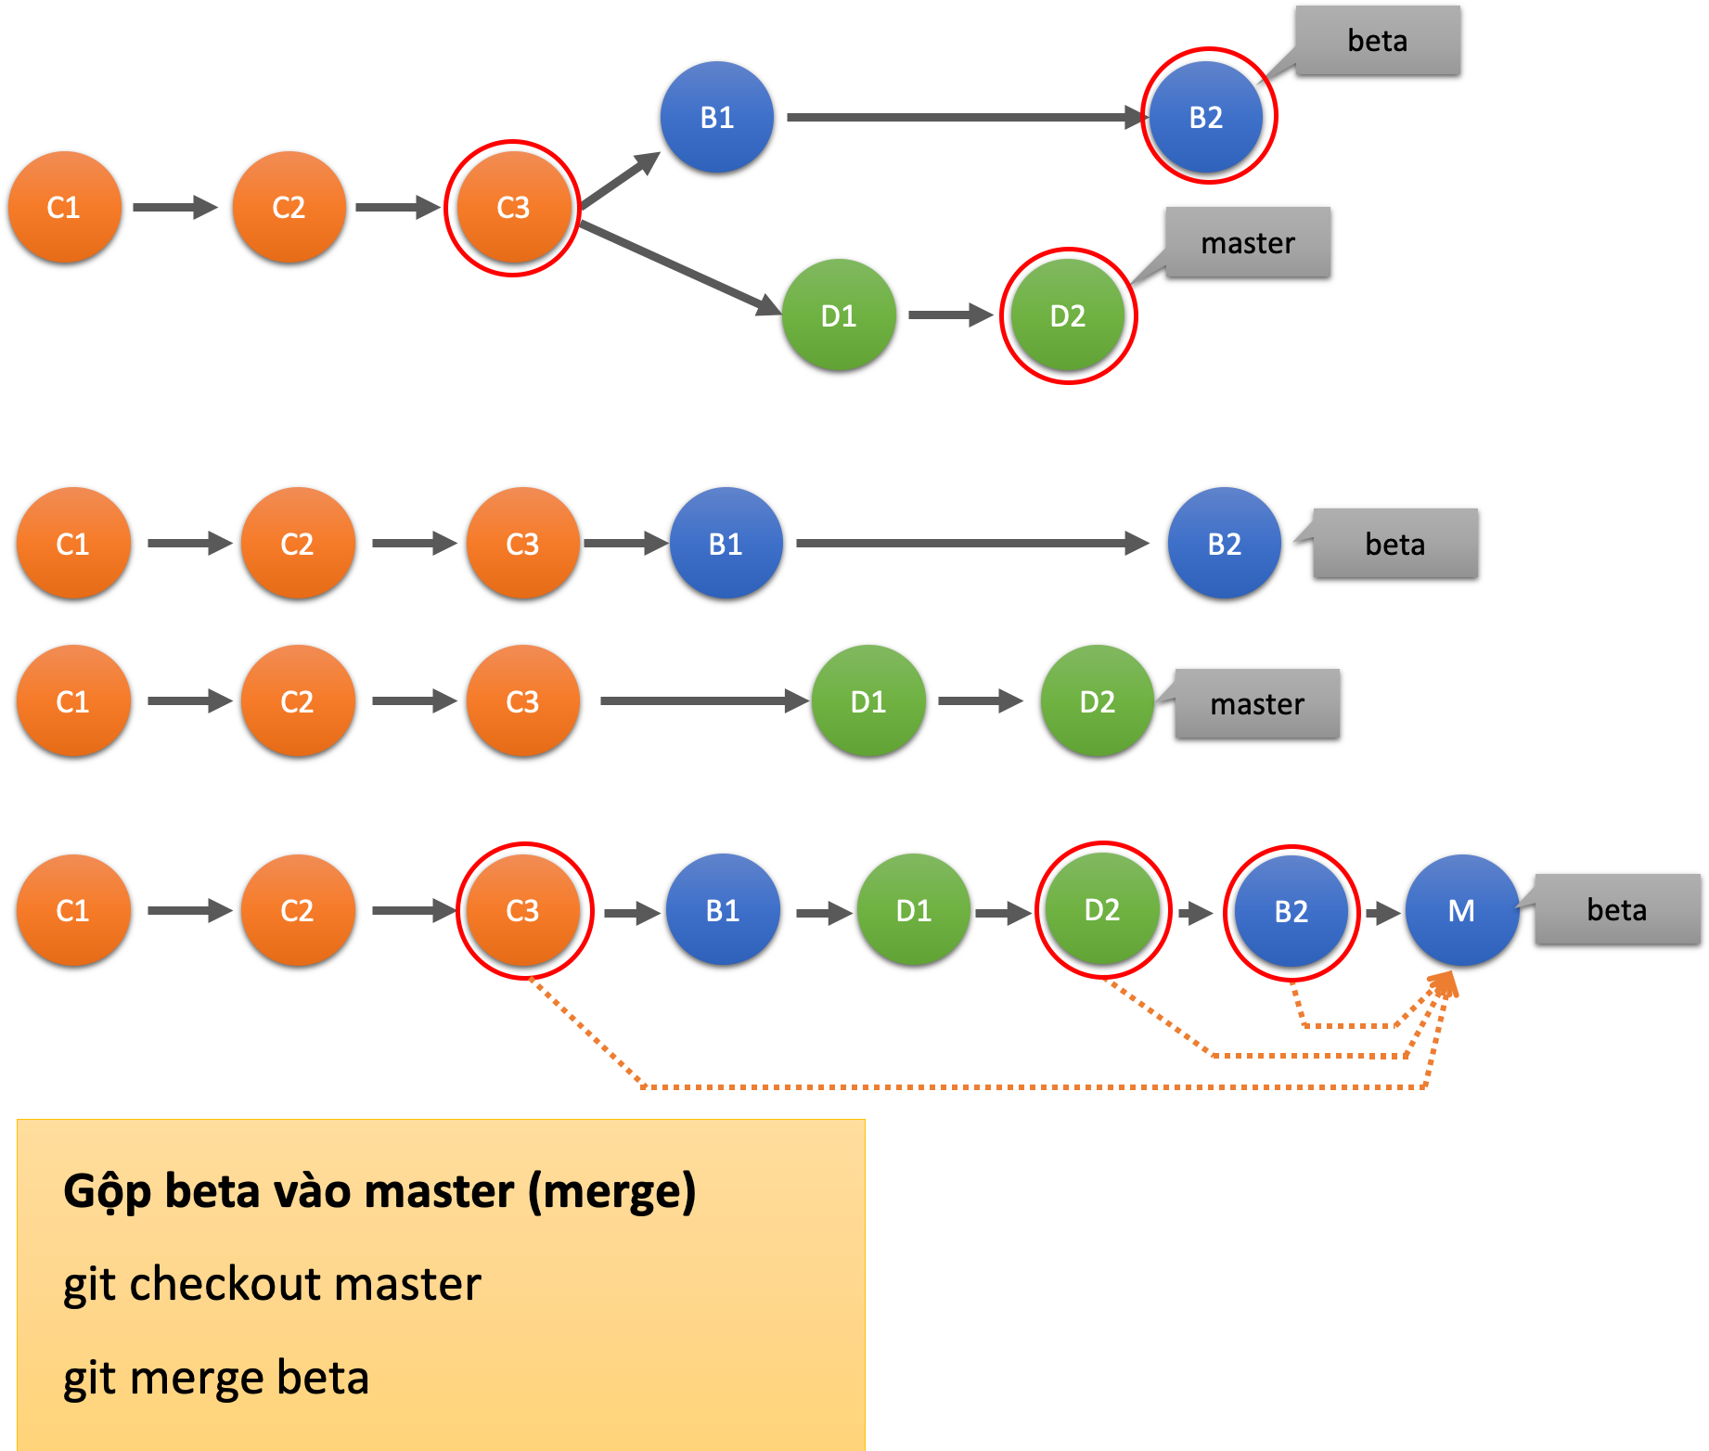
Git merge

Slide 14
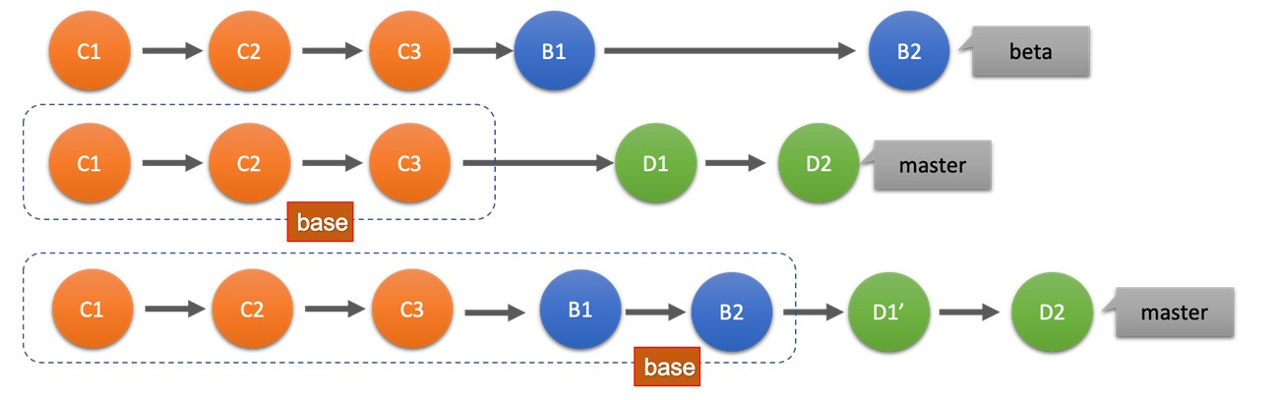
Git base

Slide 15
WORKING WITH GITHUB

Slide 16
References
Skoulikari, A. (2021, March 17). What is Git? A Beginner’s Guide to Git Version Control. FreeCodeCamp.org; freeCodeCamp.org. https://www.freecodecamp.org/news/what-is-git-learn-git-version-control
Git - Recording Changes to the Repository. (2020). Git-Scm.com. https://git-scm.com/book/en/v2/Git-Basics-Recording-Changes-to-the-Repository
Atlassian. (2023). Merging vs. Rebasing | Atlassian Git Tutorial. Atlassian. https://www.atlassian.com/git/tutorials/merging-vs-rebasing

Slide 17
Thank You!

